Slide 1
I/O Channels

Slide 2
Intro
A person‘s interaction with the outside world occurs through information being received and sent: input and output.
In an interaction with a computer the user receives information that is output by the computer, and responds by providing input to the computer – the user‘s output becomes the computer‘s input and vice versa.

Slide 3
Intro
For example, sight may be used primarily in receiving information from the computer, but it can also be used to provide information to the computer, for example by fixating on a particular screen point when using an eyegaze system.

Slide 4
Intro
There are five major senses: sight, hearing, touch, taste and smell.
Taste and smell do not currently play a significant role in HCI, and it is not clear whether they could be exploited at all in general computer systems, although they could have a role to play in more specialized systems (smells to give warning of malfunction, for example) or in augmented reality systems.
vision, hearing and touch are central.

Slide 5
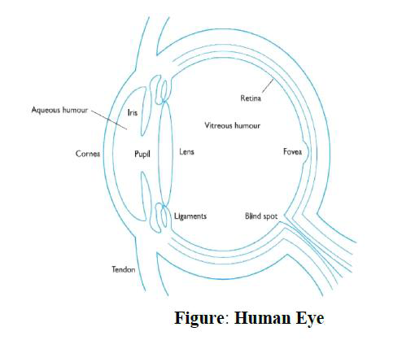
Human eye

Slide 6
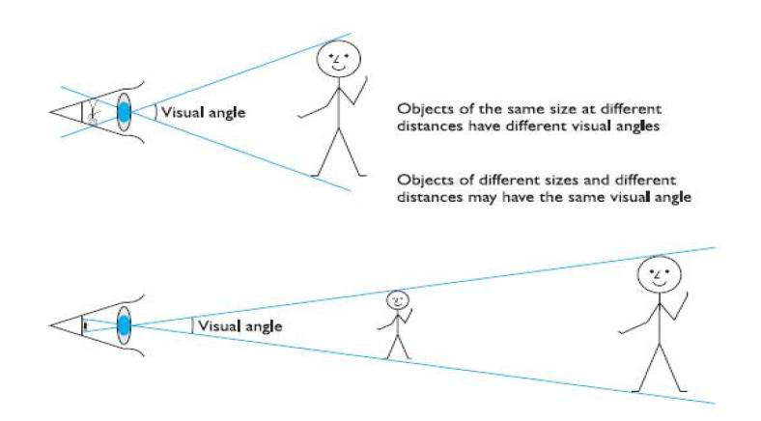
Visual perception

Slide 7
Perceiving colour
Colour is usually regarded as being made up of three components: hue, intensity and saturation.
Hue is determined by the spectral wavelength of the light. Blues have short wavelengths, greens medium and reds long. Approximately 150 different hues can be discriminated by the average person.
Intensity is the brightness of the color, and
saturation is the amount of whiteness in the color. By varying these two, we can perceive in the region of 7 million different colors.

Slide 8

The capabilities and limitations of visual processing

Slide 9


Slide 10
Hearing
The sense of hearing is often considered secondary to sight, but we tend to underestimate the amount of information that we receive through our ears.
hearing begins with vibrations in the air or sound waves.
The ear receives these vibrations and transmits them, through various stages, to the auditory nerves.
The ear comprises three sections, commonly known as the Outer ear, middle ear and inner ear.

Slide 11
Hearing – Outer Ear
The outer ear is the visible part of the ear. It has two parts: the pinna, which is the structure that is attached to the sides of the head, and the auditory canal, along which sound waves are passed to the middle ear.
Purposes
First, it protects the sensitive middle ear from damage.
The auditory canal contains wax which prevents dust, dirt and over-inquisitive insects reaching the middle ear. It also maintains the middle ear at a constant temperature.
Secondly, the pinna and auditory canal serve to amplify some sounds.

Slide 12
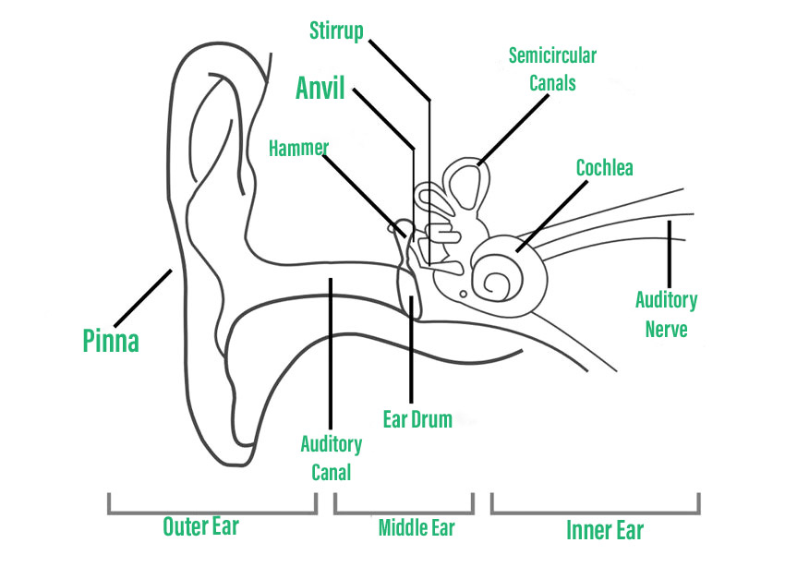
Human Ear

Slide 13
Hearing – Middle and Inner Ear
The middle ear is a small cavity connected to the outer ear by the tympanic membrane, or ear drum, and to the inner ear by the cochlea. Within the cavity are the ossicles, the smallest bones in the body.
Sound waves pass along the auditory canal and vibrate the ear drum which in turn vibrates the ossicles, which transmit the vibrations to the cochlea, and so into the inner ear.
This relay is required because, unlike the air-filled outer and middle ears, the inner ear is filled with a denser cochlean liquid. If passed directly from the air to the liquid, the transmission of the sound waves would be poor.
By transmitting them via the ossicles the sound waves are concentrated and amplified.

Slide 14
Touch
Touch provides us with vital information about our environment. It tells us when we touch something hot or cold, and can therefore act as a warning.
It also provides us with feedback when we attempt to lift an object, for example. Consider the act of picking up a glass of water.
If we could only see the glass and not feel when our hand made contact with it or feel its shape, the speed and accuracy of the action would be reduced.

Slide 15
Touch
This is the experience of users of certain virtual reality games: they can see the computer-generated objects which they need to manipulate but they have no physical sensation of touching them.
Watching such users can be an informative and amusing experience! Touch is therefore an important means of feedback, and this is no less so in using computer systems.

Slide 16
Feeling buttons depress is an important part of the task of pressing the button. Also, we should be aware that, although for the average person, haptic perception is a secondary source of information, for those whose other senses are impaired, it may be vitally important.
The skin contains three types of sensory receptor:
Thermo receptors respond to heat and cold,
Nociceptors respond to intense pressure, heat and pain, and
Mechanoreceptors respond to pressure.

